Slide 1
UPCASTING AND DOWNCASTING IN JAVA
Prepared By: Dimple Bohra

Slide 2
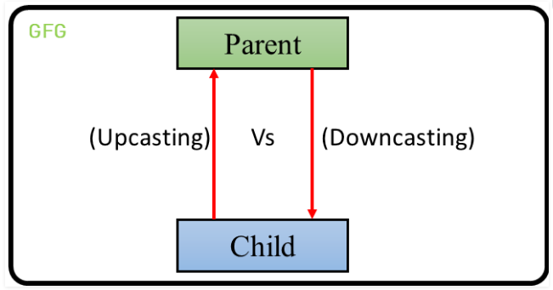

Slide 3
Typecasting in Inheritance
Typecasting is one of the most important concepts which basically deals with the conversion of one data type to another data type implicitly or explicitly.
Just like the data types, the objects can also be typecasted.
However, in objects, there are only two types of objects (i.e.) parent object and child object.
Therefore, typecasting of objects basically mean that one type of object (i.e.) child or parent to another.

Slide 4
Types of typecasting
1. Upcasting: Upcasting is the typecasting of a child object to a parent object.
Upcasting can be done implicitly.
Upcasting gives us the flexibility to access the parent class members but it is not possible to access all the child class members using this feature.
Instead of all the members, we can access some specified members of the child class. For instance, we can access the overridden methods.
2. Downcasting: Similarly, downcasting means the typecasting of a parent object to a child object.
Downcasting cannot be done implicitly.
Notes:
Example: Let there be a parent class. There can be many children of a parent. Let’s take one of the children into consideration. The child inherits the properties of the parent. Therefore, there is an “is-a” relationship between the child and parent. Therefore, the child can be implicitly upcasted to the parent. However, a parent may or may not inherits the child’s properties. However, we can forcefully cast a child to a parent which is known as downcasting. After we define this type of casting explicitly, the compiler checks in the background if this type of casting is possible or not. If it’s not possible, the compiler throws a ClassCastException.

Slide 5
class Parent
{
String name;
void method()
{
System.out.println("Method from Parent");
}
}
class Child extends Parent
{
int id;
void method()
{
System.out.println("Method from Child");
}
}
public class Castingtest
{
public static void main(String[] args)
{
Parent p = new Child();
p.name="IT,VESIT";
p.id=1;
System.out.println(p.name);
p.method();
/*Child c = (Child)p;
c.id = 1;
System.out.println(c.name);
System.out.println(c.id);
c.method(); */
}
}

Slide 6
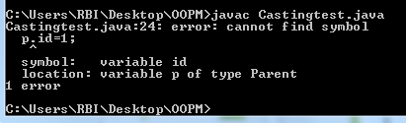
class Parent
{
String name;
void method()
{
System.out.println("Method from Parent");
}
}
class Child extends Parent
{
int id;
void method()
{
System.out.println("Method from Child");
}
}
public class Castingtest
{
public static void main(String[] args)
{
Parent p = new Child();
p.name="IT,VESIT";
p.id=1;
System.out.println(p.name);
p.method();
/*Child c = (Child)p;
c.id = 1;
System.out.println(c.name);
System.out.println(c.id);
c.method(); */
}
}

Slide 7
class Parent
{
String name;
void method()
{
System.out.println("Method from Parent");
}
}
class Child extends Parent
{
int id;
void method()
{
System.out.println("Method from Child");
}
}
public class Castingtest
{
public static void main(String[] args)
{
/* Parent p = new Child();
p.name="IT,VESIT";
p.id=1;
System.out.println(p.name);
p.method(); */
Child c = new Parent();
c.id = 1;
c.name=“IT,VESIT”;
System.out.println(c.name);
System.out.println(c.id);
c.method();
}
}

Slide 8
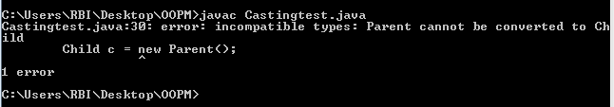
class Parent
{
String name;
void method()
{
System.out.println("Method from Parent");
}
}
class Child extends Parent
{
int id;
void method()
{
System.out.println("Method from Child");
}
}
public class Castingtest
{
public static void main(String[] args)
{
/* Parent p = new Child();
p.name="IT,VESIT";
p.id=1;
System.out.println(p.name);
p.method(); */
Child c = new Parent();
c.id = 1;
c.name=“IT,VESIT”;
System.out.println(c.name);
System.out.println(c.id);
c.method();
}
}

Slide 9
class Parent
{
String name;
void method()
{
System.out.println("Method from Parent");
}
}
class Child extends Parent
{
int id;
void method()
{
System.out.println("Method from Child");
}
}
public class Castingtest
{
public static void main(String[] args)
{
Parent p = new Child();
p.name="IT,VESIT";
System.out.println(p.name);
p.method();
Child c = (Child)p;
c.id = 1;
System.out.println(c.name);
System.out.println(c.id);
c.method();
}
}

Slide 10
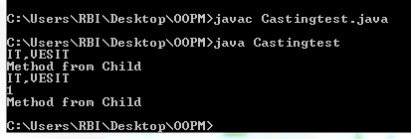
class Parent
{
String name;
void method()
{
System.out.println("Method from Parent");
}
}
class Child extends Parent
{
int id;
void method()
{
System.out.println("Method from Child");
}
}
public class Castingtest
{
public static void main(String[] args)
{
Parent p = new Child();
p.name="IT,VESIT";
System.out.println(p.name);
p.method();
Child c = (Child)p;
c.id = 1;
System.out.println(c.name);
System.out.println(c.id);
c.method();
}
}

